Slide 1
What we’re up to today and next week
Today:
Talk about new data from Ke et al => why we need Cambio 4.0
Float some ideas about your research projects
Float the idea of modeling social change
Group selection and work
Next week (Week 12)
Monday:
Guest lecturer Professor Richard Anderson-Connolly (SOAN), on popular social movements. See the Discussion item in the Week 11 Canvas page (extra credit).
Wednesday:
1st set of presentations of social change model findings (2-3 presentations, 5-10 minutes each)
Introduction to the ClimateStatistics Python module
Friday:
Remaining presentations of social change model findings

Slide 2
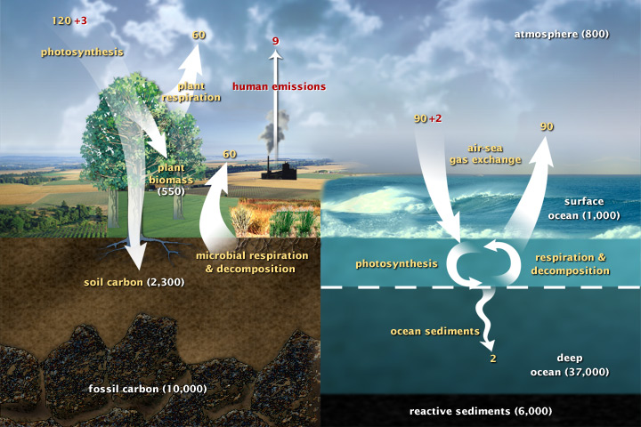
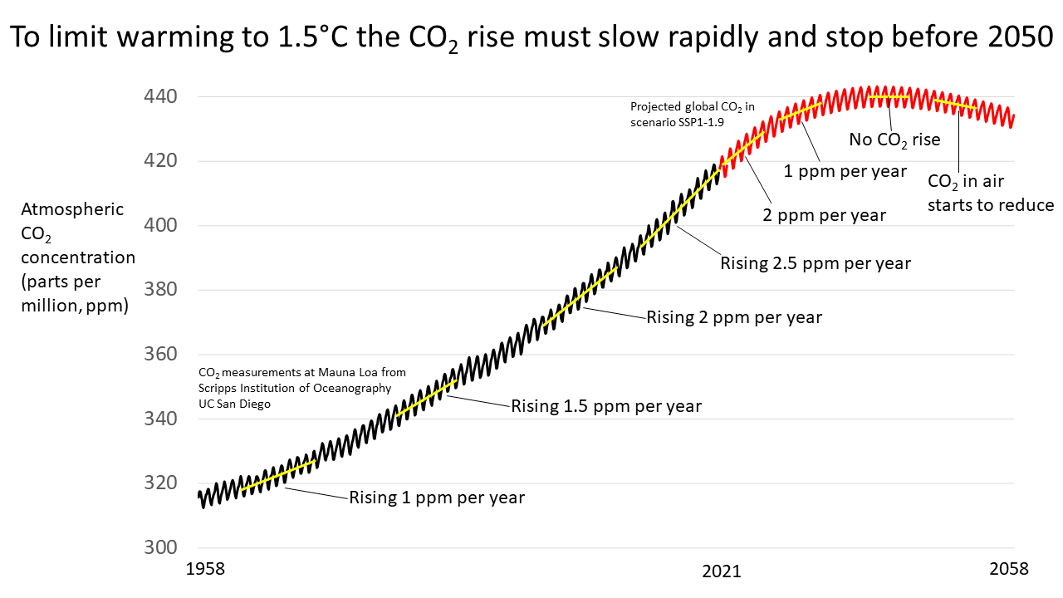
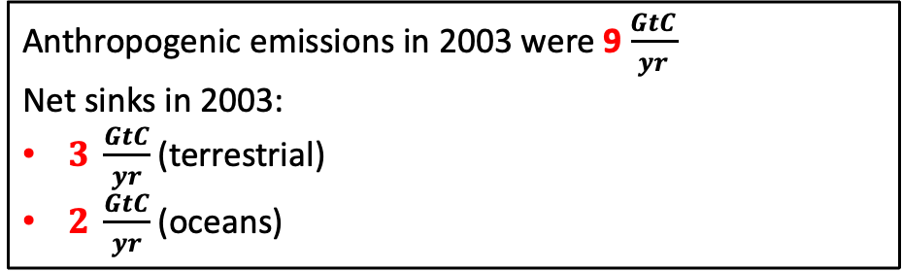
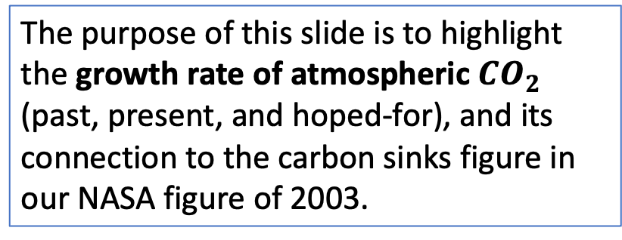
Connection between growth rate of atmospheric $CO_{2}$, emissions rates, and net carbon sinks
Anthropogenic emissions in 2003 were 9$\frac{GtC}{yr}$
Net sinks in 2003:
$3 \frac{GtC}{yr}$(terrestrial)
$2 \frac{GtC}{yr}$(oceans)
2003
The purpose of this slide is to highlight the growth rate of atmospheric $CO_{2}$ (past, present, and hoped-for), and its connection to the carbon sinks figure in our NASA figure of 2003.
2003
https://allianceforscience.org/wp-content/uploads/2022/01/Keeling-curve-with-SSP1-1.9-all-trend-labels.png

Slide 3
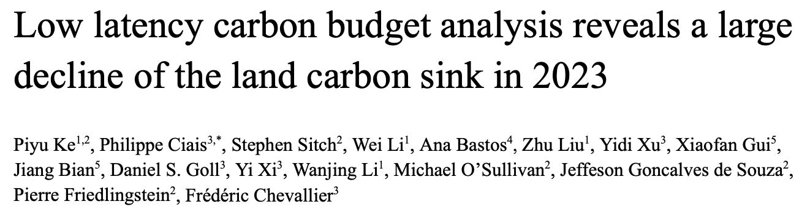
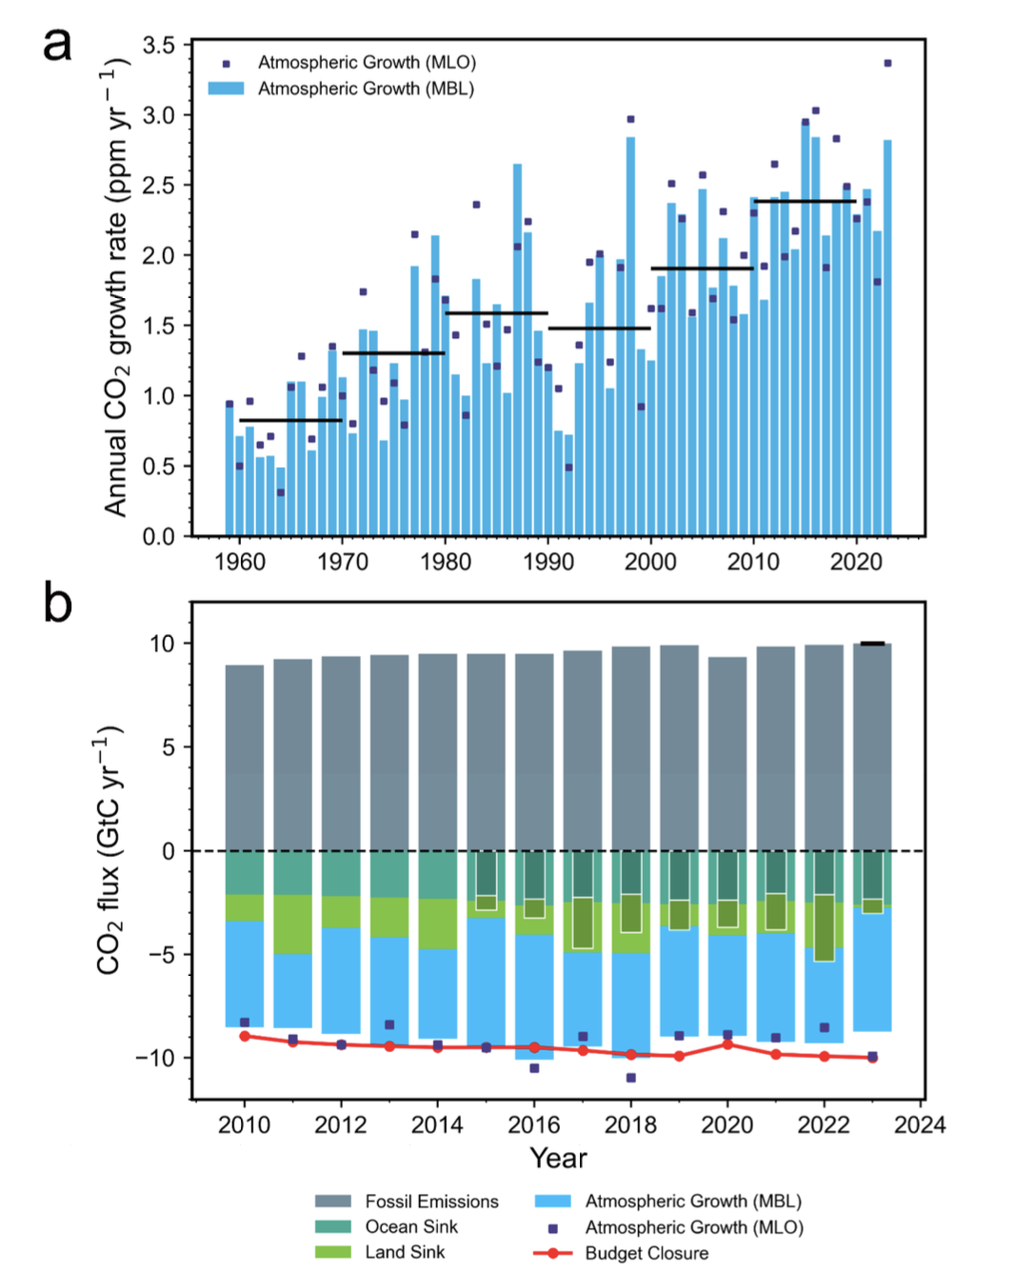
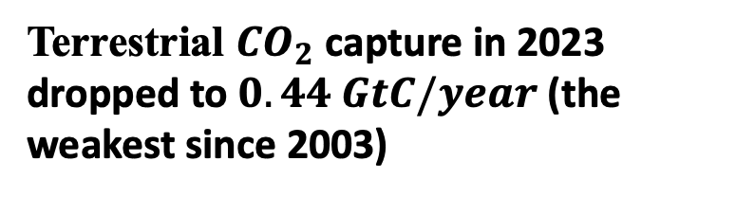
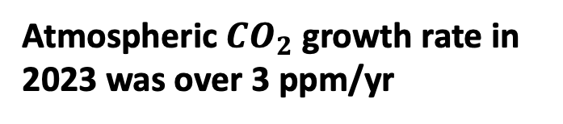
What changed in 2023: the terrestrial carbon sink
Terrestrial $CO_{2}$ capture in 2023 dropped to $0.44 GtC/year$ (the weakest since 2003)
Atmospheric $CO_{2}$ growth rate in 2023 was over 3 ppm/yr

Slide 4
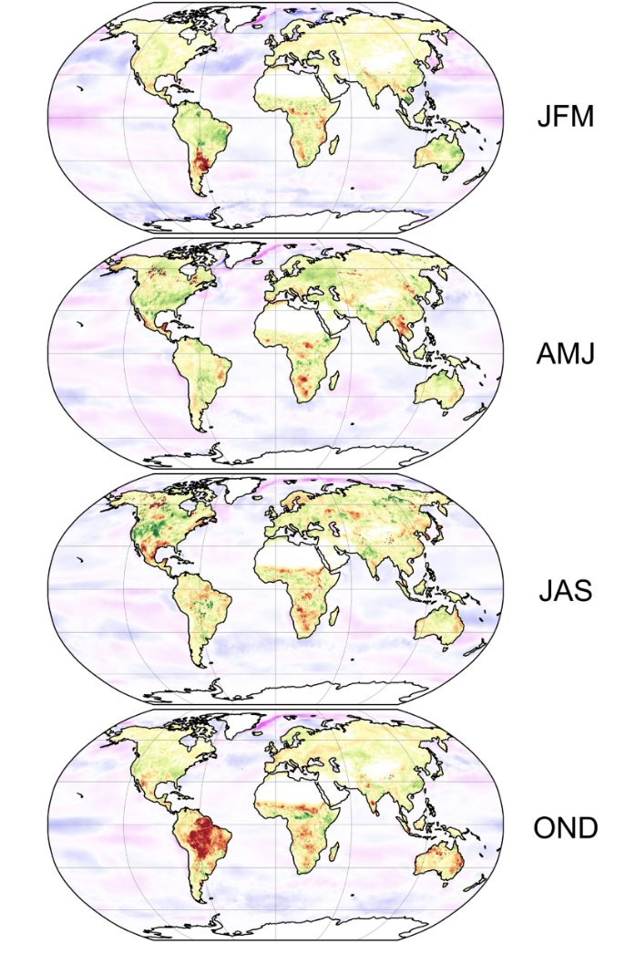
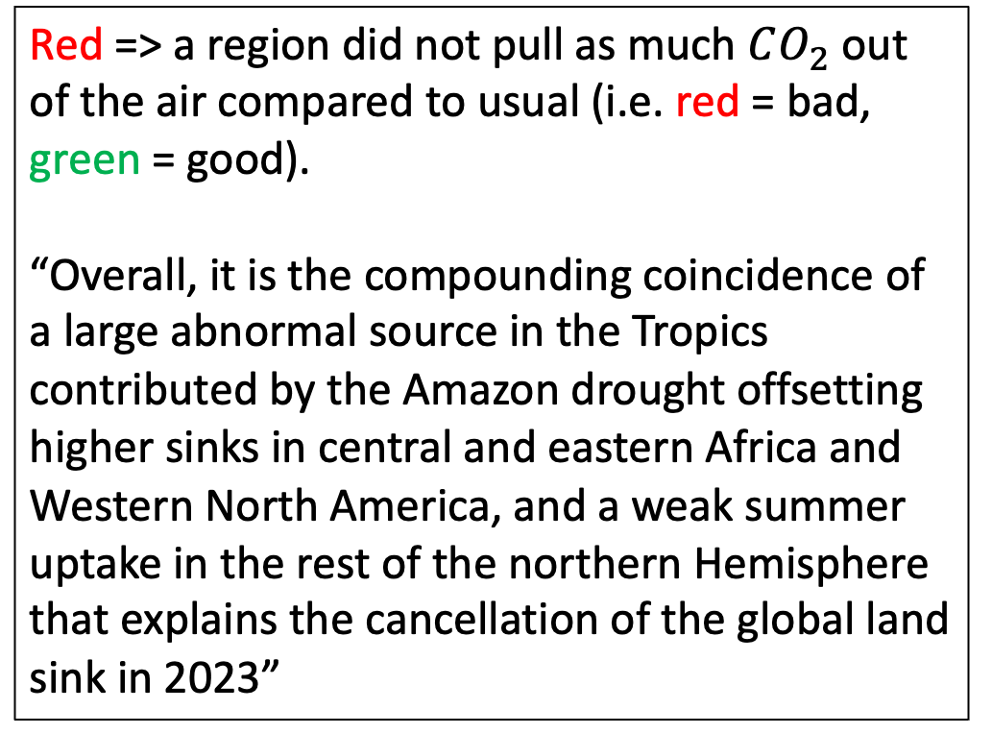
Where did we lose the sink?
2023
Red => a region did not pull as much $CO_{2}$ out of the air compared to usual (i.e. red = bad, green = good).
“Overall, it is the compounding coincidence of a large abnormal source in the Tropics contributed by the Amazon drought offsetting higher sinks in central and eastern Africa and Western North America, and a weak summer uptake in the rest of the northern Hemisphere that explains the cancellation of the global land sink in 2023”
NH winter
---------------
SH summer
NH spring
---------------
SH fall
NH summer
---------------
SH winter
NH fall
---------------
SH spring

Slide 5
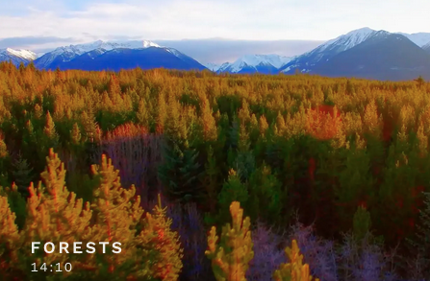
It’s not like the trend is a huge surprise, it’s just coming on faster than we thought
2021 (Richard Gere and friends)

Slide 6
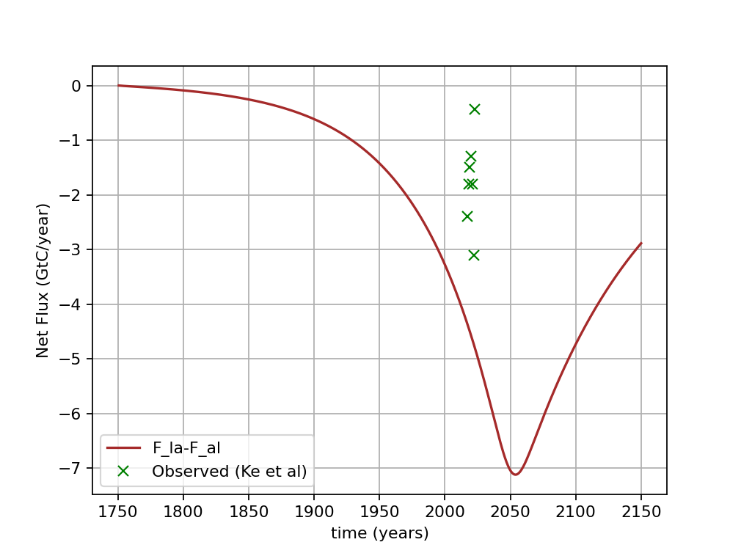
Here’s our old (Cambio 3.0) estimate of the terrestrial land sink next to Ke et al’s data
Carbon budget from 2010-2023.

Slide 7
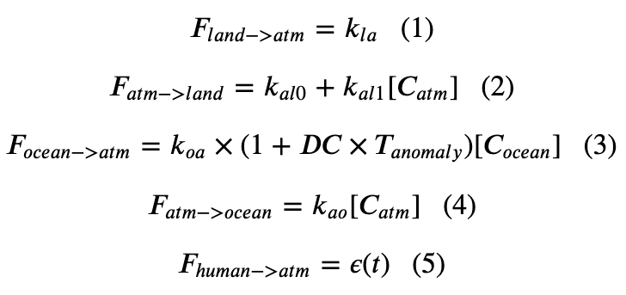
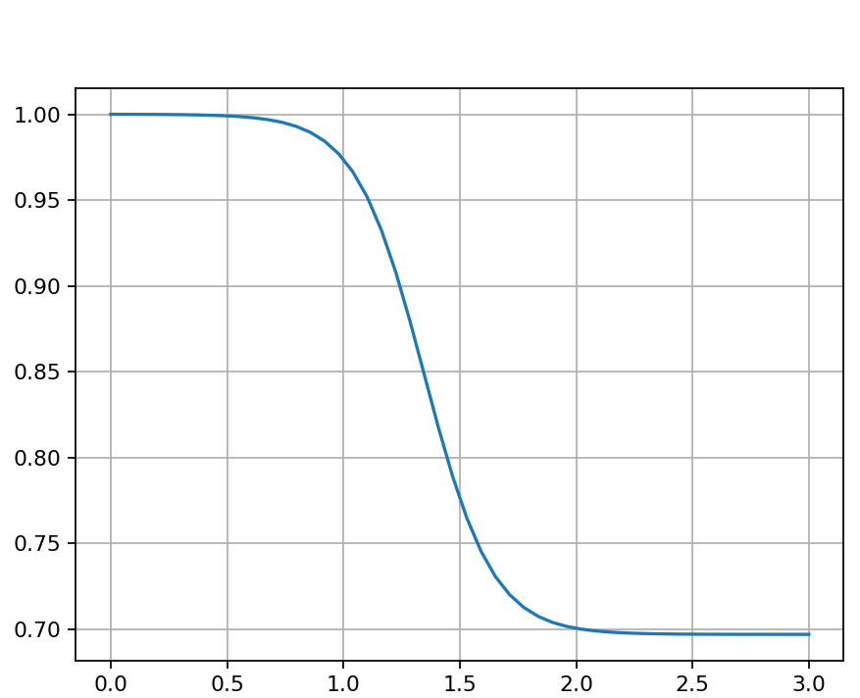
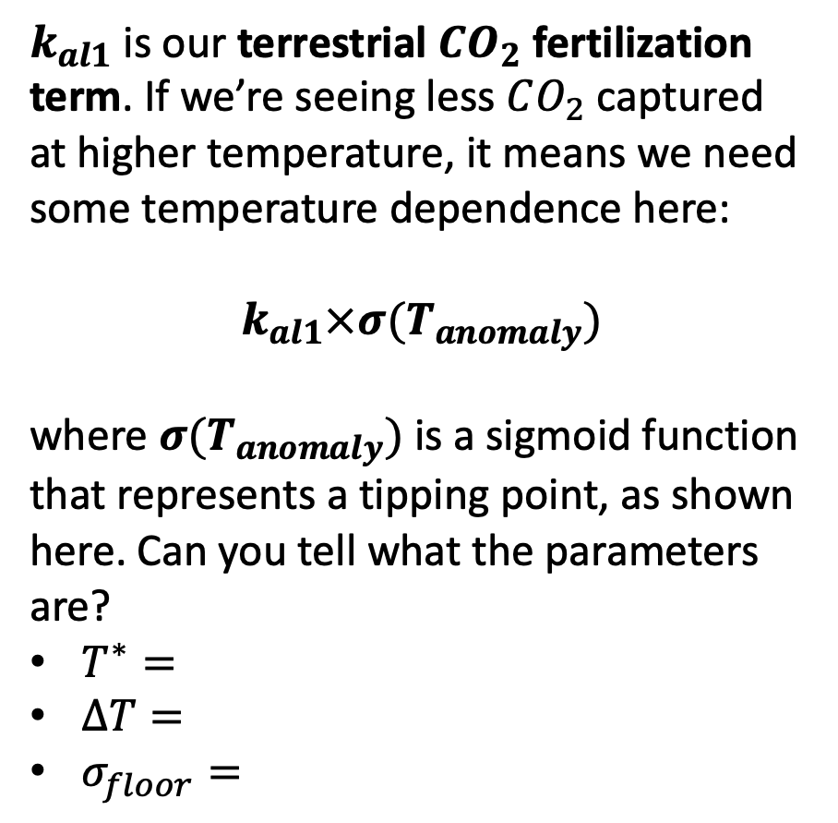
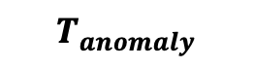
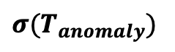
How Cambio 4.0 accounts for a reduction in the land sink
$k_{al1}$is our terrestrial $CO_{2}$ fertilization term. If we’re seeing less $CO_{2}$ captured at higher temperature, it means we need some temperature dependence here:
$k_{al1}×σ(T_{anomaly})$
where $σ(T_{anomaly})$ is a sigmoid function that represents a tipping point, as shown here. Can you tell what the parameters are?
$T^{∗}=$
$∆T=$
$σ_{floor}=$
$$σ(T_{anomaly})$$
$$T_{anomaly}$$

Slide 8
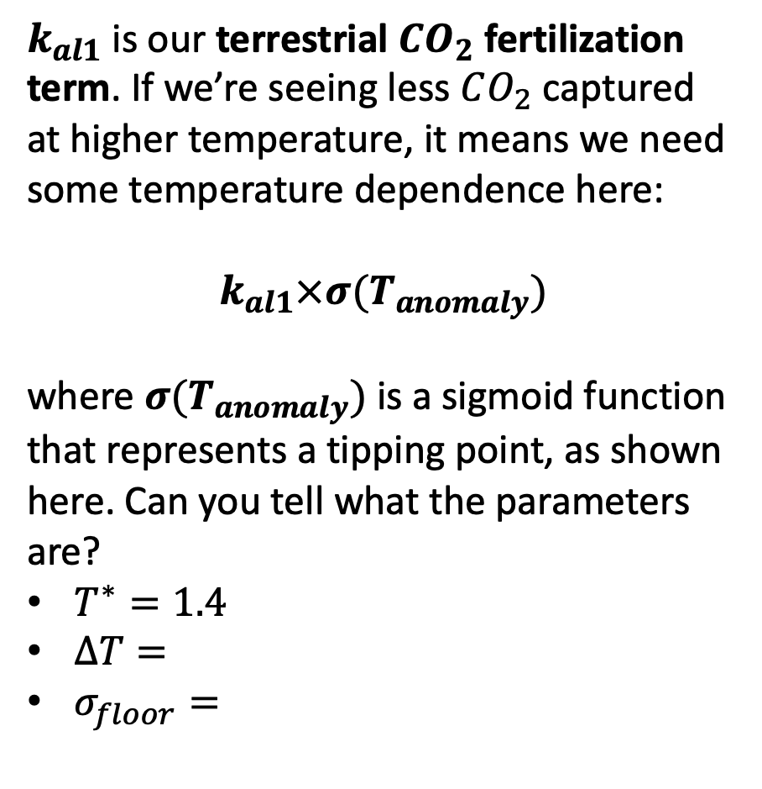
How Cambio 4.0 accounts for a reduction in the land sink
$k_{al1}$is our terrestrial $CO_{2}$ fertilization term. If we’re seeing less $CO_{2}$ captured at higher temperature, it means we need some temperature dependence here:
$k_{al1}×σ(T_{anomaly})$
where $σ(T_{anomaly})$ is a sigmoid function that represents a tipping point, as shown here. Can you tell what the parameters are?
$T^{∗}=1.4$
$∆T=$
$σ_{floor}=$
$$σ(T_{anomaly})$$
$$T_{anomaly}$$

Slide 9
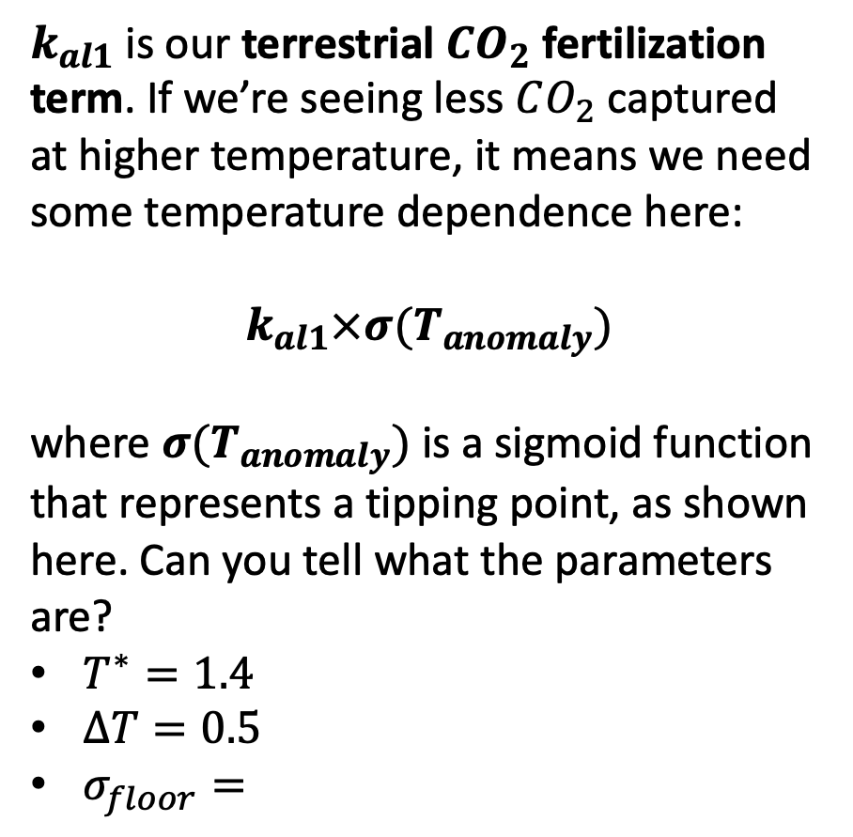
How Cambio 4.0 accounts for a reduction in the land sink
$k_{al1}$is our terrestrial $CO_{2}$ fertilization term. If we’re seeing less $CO_{2}$ captured at higher temperature, it means we need some temperature dependence here:
$k_{al1}×σ(T_{anomaly})$
where $σ(T_{anomaly})$ is a sigmoid function that represents a tipping point, as shown here. Can you tell what the parameters are?
$T^{∗}=1.4$
$∆T=0.5$
$σ_{floor}=$
$$σ(T_{anomaly})$$
$$T_{anomaly}$$

Slide 10
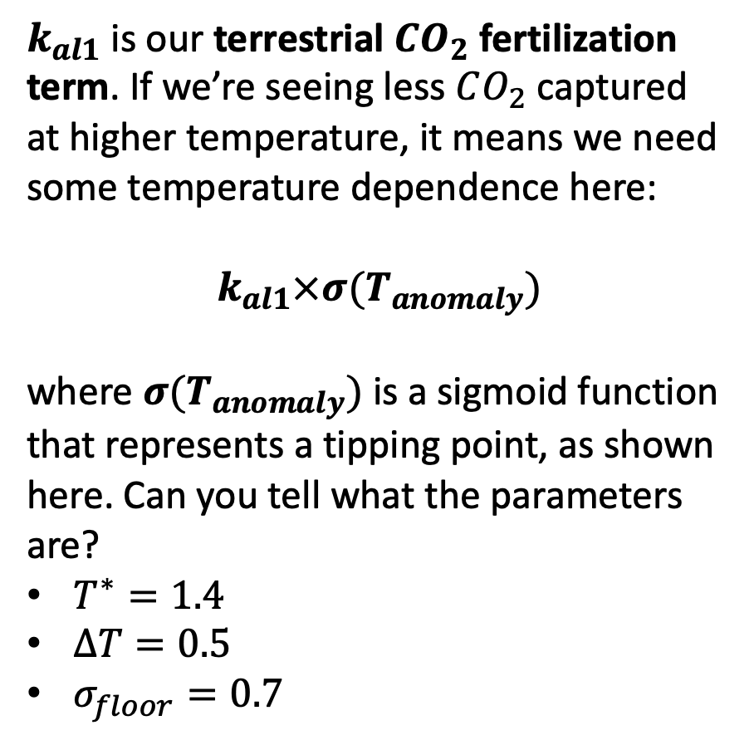
How Cambio 4.0 accounts for a reduction in the land sink
$k_{al1}$is our terrestrial $CO_{2}$ fertilization term. If we’re seeing less $CO_{2}$ captured at higher temperature, it means we need some temperature dependence here:
$k_{al1}×σ(T_{anomaly})$
where $σ(T_{anomaly})$ is a sigmoid function that represents a tipping point, as shown here. Can you tell what the parameters are?
$T^{∗}=1.4$
$∆T=0.5$
$σ_{floor}=0.7$
$$σ(T_{anomaly})$$
$$T_{anomaly}$$

Slide 11
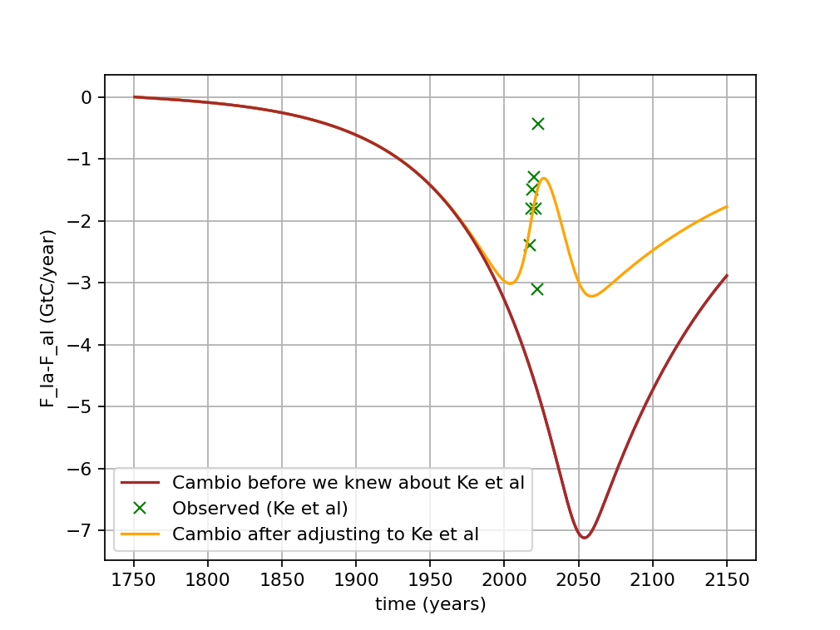
Here’s Cambio 4.0’s new estimate of the terrestrial land sink (after assimilating Ke et al’s data as best we can)
Carbon budget from 2010-2023.

